Slide 1
Map design
Author : Logan
Version 0.1 (draft)

Slide 2
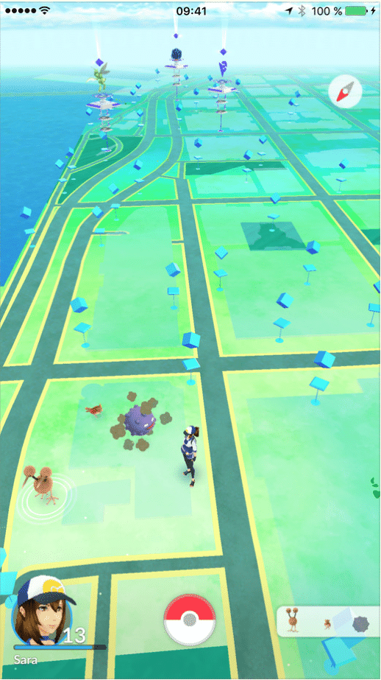
Map screen
A safety app that allows you to review streets based off their danger levels
“name of street”
Danger level - 1
Would use a similar design Pokémon go has, with a indicator for user location via gps and then detailing whether the street the user is at is considered “dangerous” based off reviews by users of the community and their experiences
Levels description
Level 1 – No concern at any point of the day.
Level 2 – Take caution at Nighttime.
Level 3 – Take caution at all points of the day.

Slide 3
Implementations
The map could be implemented in two different examples, following google maps examples.
You can view streets around like on google maps, but with their level ratings and reviews.
Tracks you via gps and notifies you to your phone about any ‘dangerous streets you are on.
When planning a route, it could suggest less dangerous routes to avoid high level zones.

Slide 4
Concerns
Privacy concerns, Users have to consent to their location being used. Both in app and background
Rating – Rating streets can be considered ‘rude’ to the people living on the street
User generated data quality – Needs to make sure reviews are accurate and reliable
Data verification – is there any mechanism to verify the information provided by users, such as cross referencing with official crime statistics
Engagement – How would users keep being engaged with the app?

Slide 5
Answers to concerns.
Privacy concerns – User data will only be used to provide reviews, and verify that they have visited the area, the main concern is making sure that users aren’t able to be tracked to their homes based on their reviews, an anonymous system could work but would decline user engagement. Users can view their reviewed streets, but other users can only review the street reviews, a good blend of keeping user engagement but keeping it anonymous.

Slide 6
Answers to concerns cont. (Rating)
To avoid rating’s being inaccurate, the app will require that a user must been on the street and find what time the user was present on the street. E.G if a street is reviewed positively and negatively by the same user, time will be considered on the level of danger. To avoid users having to stop and review, a separate tab will be used as a ‘streets you’ve been on’ so users can walk the streets and then review them later.
Reviews will be able to be voted on by the community, to avoid being too harsh funny reviews will be kept in but filtered out to their own filter so the best reviews will be on time. If possible time filters will exist as well.

Slide 7
Answers to concerns (Engagement)
To keep user engagement, a levelling system will be used, for users that review a lot of streets, have positive reviews and positive reactions by the community, will get a higher level and badges based on their contributions, this is to encourage users to be outstanding members of the community and contribute to the safety of users on the app and to be commended/commending reviewers, this can also be used the other way to reamend users who give fake reviews/bad information.

Slide 8
Version history
Version | Date | Changes
0.1 | 17/06/24 | Added concerns and potential answers/ as well as app idea and implementation

